Slide 1
THE WORK OF INTERNATIONAL AND RUSSIAN ACADEMIES OF ENGINEERING

Slide 13
Cement powders (10-80) mm; (10-80) • 10⁴ nm Finely grained particles (aggregates) 10⁴ – 10³ nm Ultradispersed aggregates 10³ – 10² nm Nanomaterials less than 10² nm

Slide 22
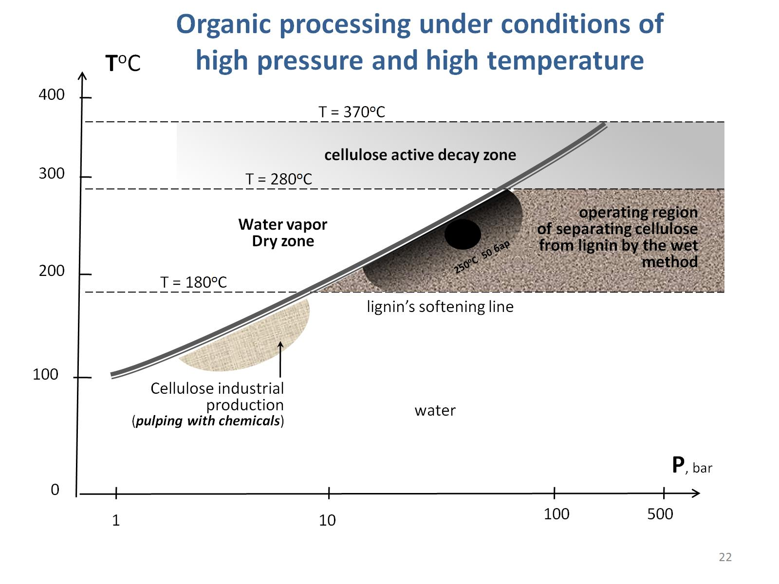

Slide 27
(3D) fluctuation measurement

Slide 34
III All-Russian (II International) Conference on Concrete and Reinforced Concrete Moscow, 2014

Slide 36
